Slide 1
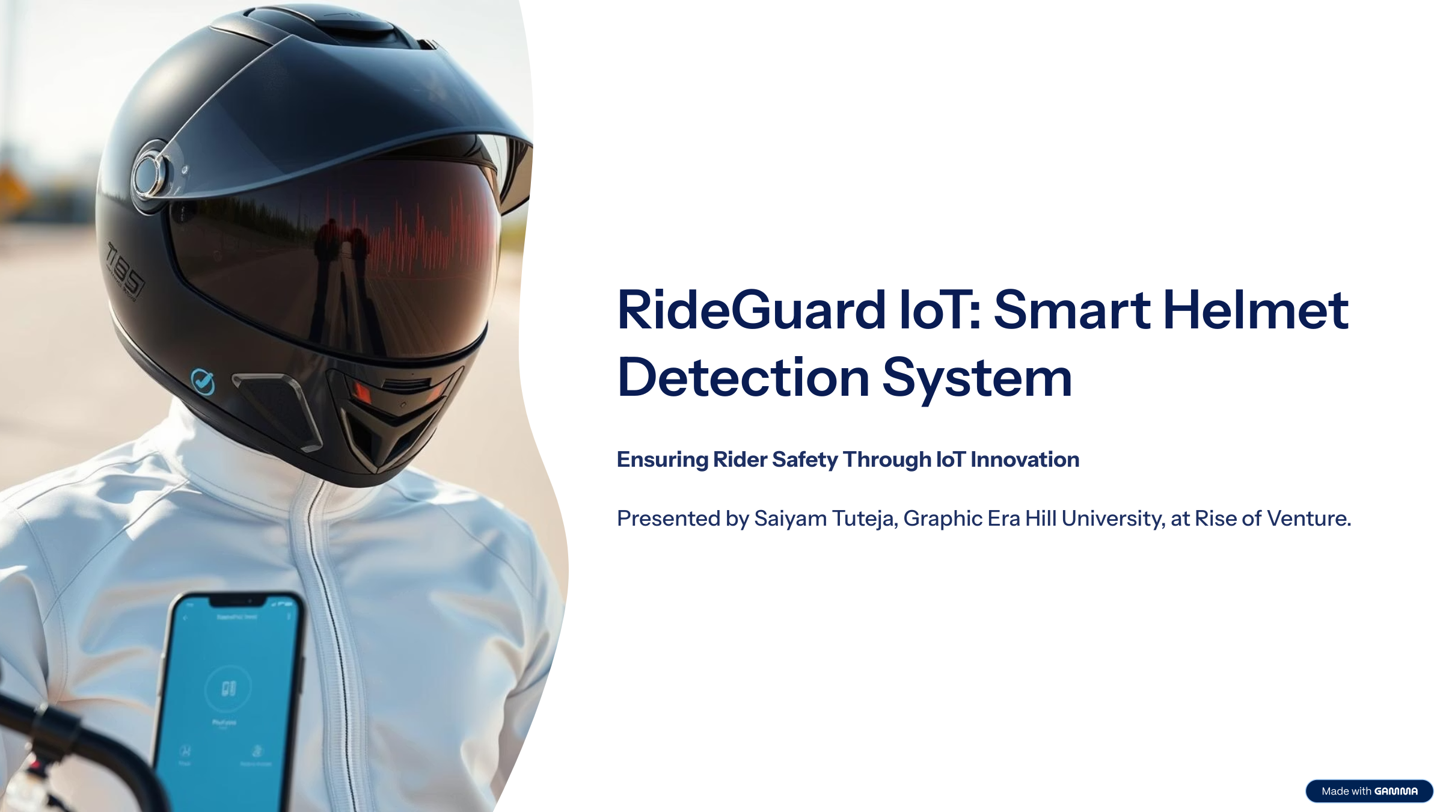

Slide 2
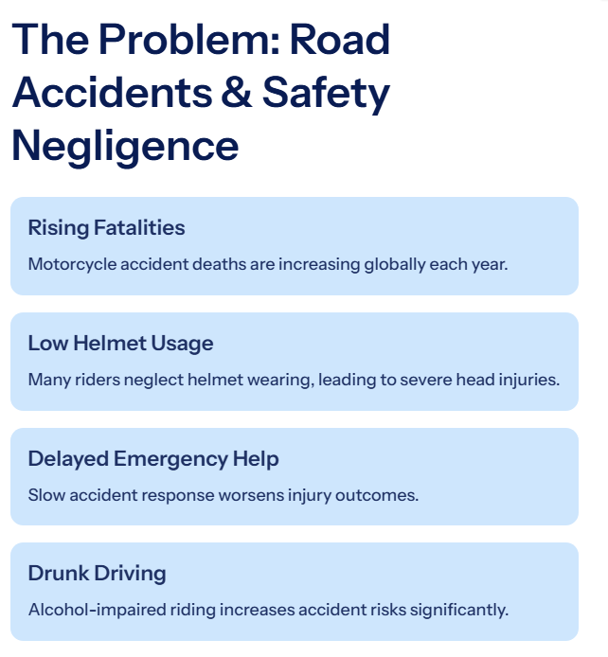
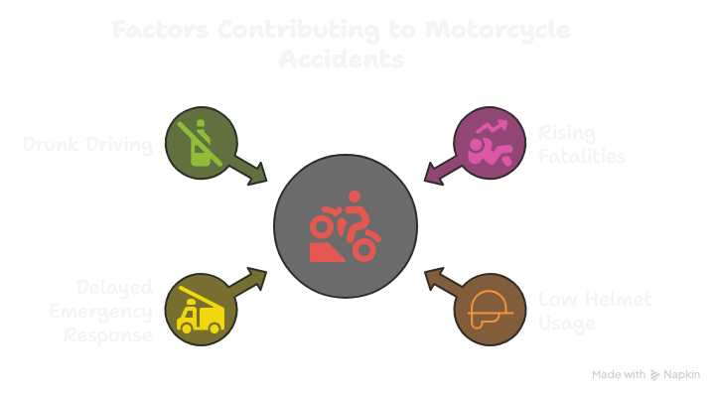

Slide 3
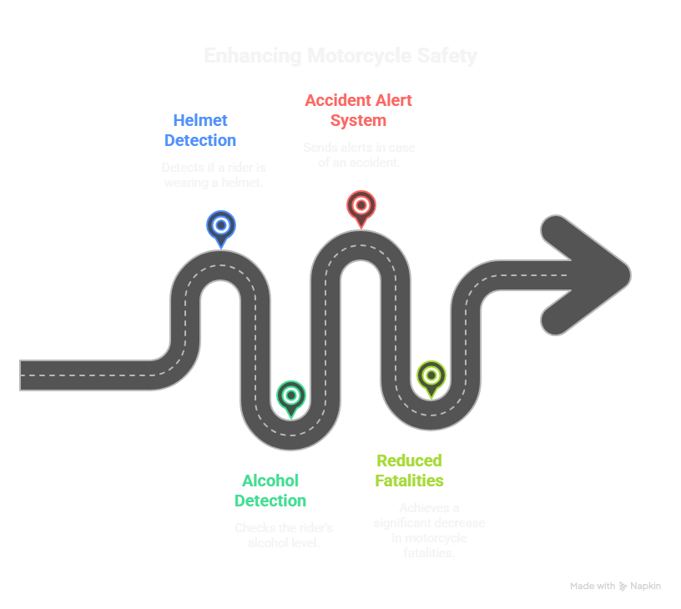
Innovative Safety Features
Dual-Helmet Detection
Alcohol Monitoring System
Ensures both riders wear helmets, enhancing safety during rides.
Accident Alert Mechanism
Instant notifications to emergency contacts when an accident is detected.
Real-Time Monitoring
Continuous tracking of rider's alcohol levels for safer travel.

Slide 4
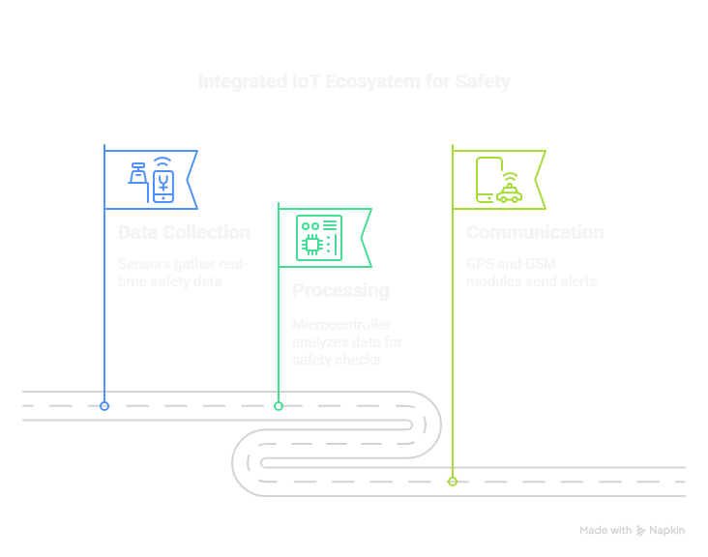
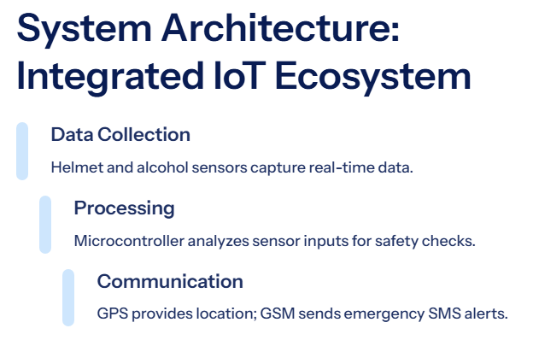
System Architecture: Integrated IoT Ecosystem

Slide 5
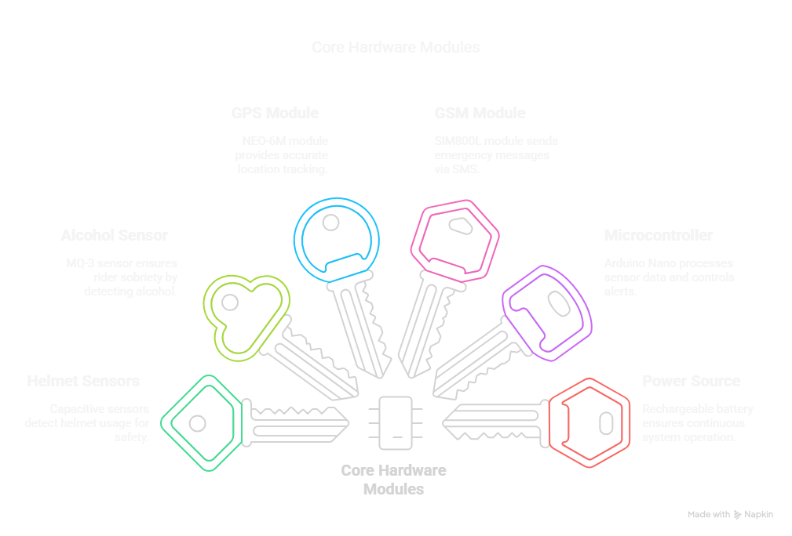

Slide 6
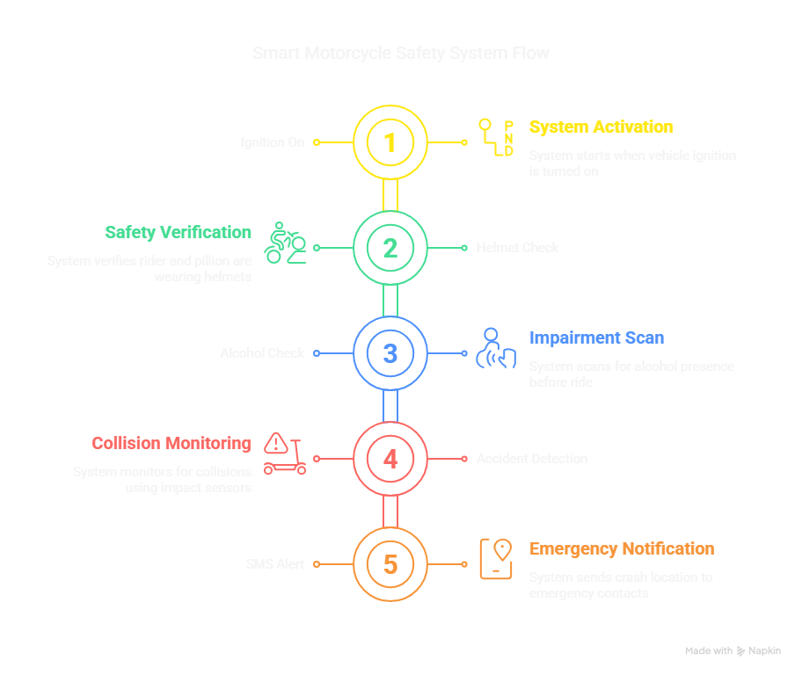
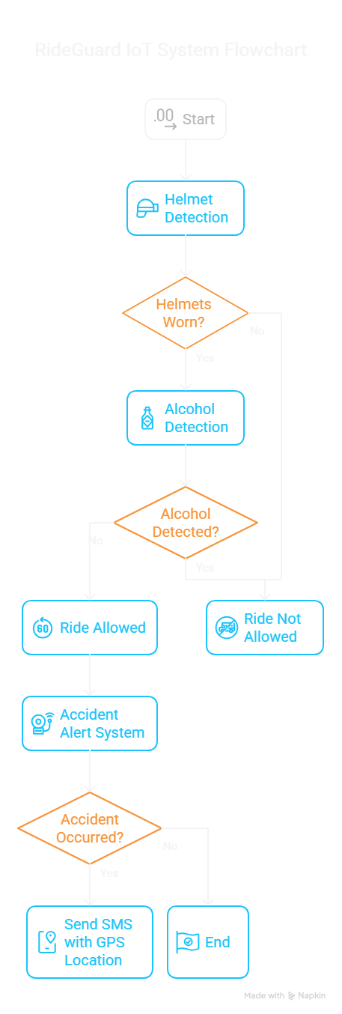

Slide 7
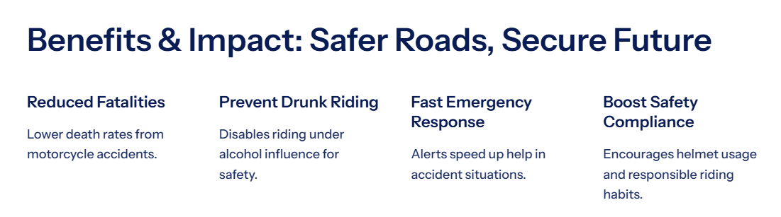
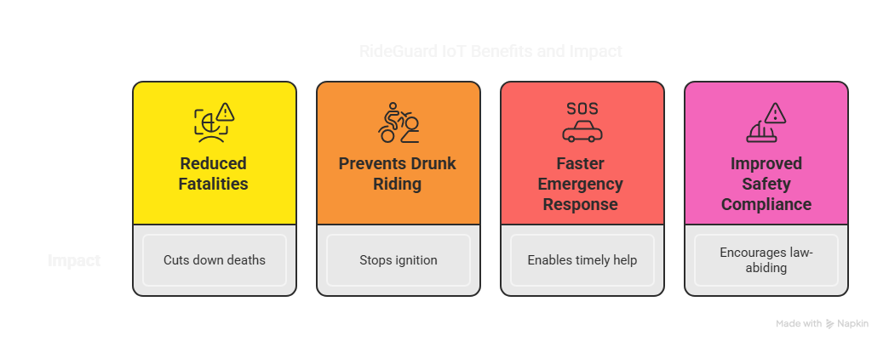

Slide 8

Do you have any questions?
Thank you for your attention
I welcome your queries and feedback!

